Slide 1
VG Development – Media and Interactivity
Interactive Media
Unit 1

Slide 2

Starter – 5 Minutes
Log in and fill your answers into your worksheet.
Can you list the different ways in which information is shown to the user on Microsoft Word?

Slide 3

Learning Outcomes
Aspire to ……
 | Explain the effects that the different interactive elements can have on a product.
Challenge to……
 | Describe how to break down the information and interactivity of a VG.
 | Understand how a VG is an interactive media product.

Slide 4
What is VG?
VG is short for Video Games.
This isn’t a commonly used abbreviation, however, because of the school filter, VG will be used for any file names.

Slide 5
VG as an Interactive Media Product
There are two main factors to consider when producing a VG as an interactive media product:
Interactivity
Media
As with other examples, this may sound obvious, but it can easily be overlooked.

Slide 6
Media
Media just refers to means of communication, i.e. transferring information.
A VG will do this quite easily, if planned and executed properly.

Slide 7
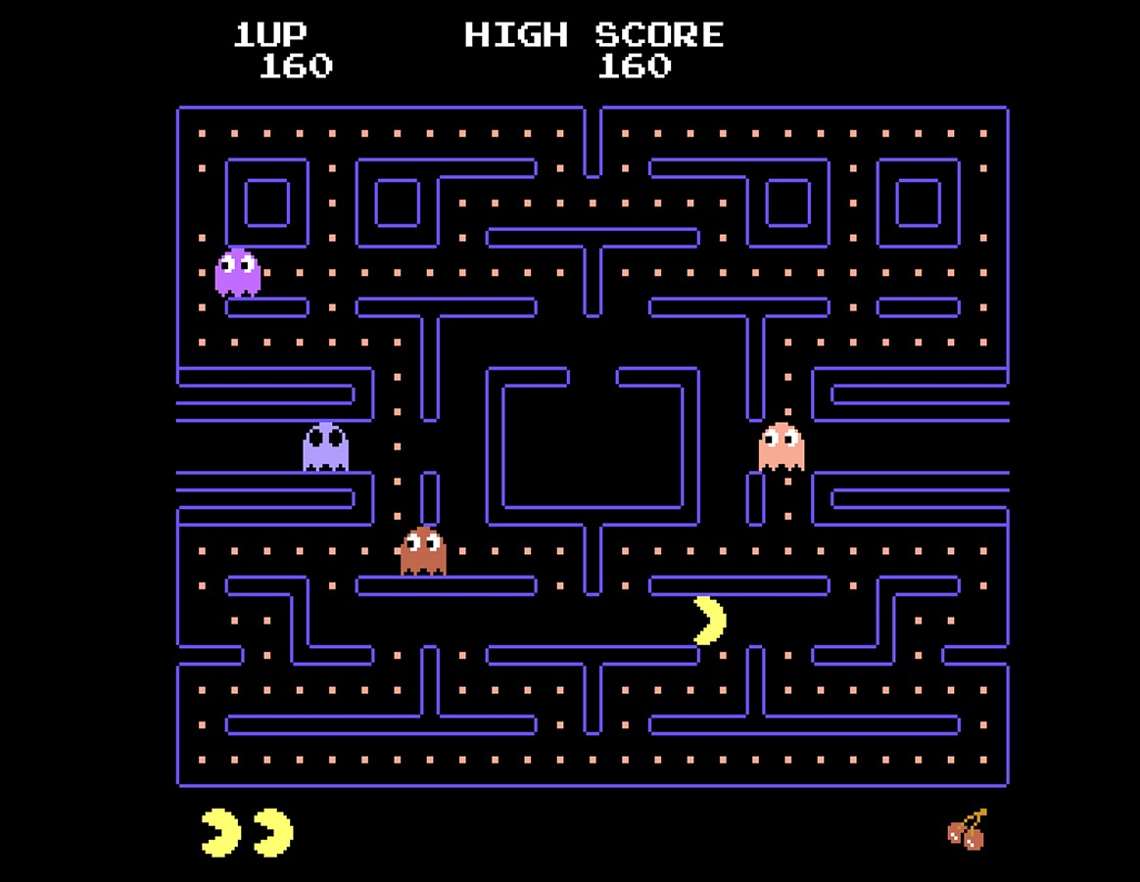
Media – Example
Discuss with your neighbours, be prepared to give your answer:
Where is information about the game being conveyed in this image?
There is a lot more than you think, some of it is more obvious.

Slide 8

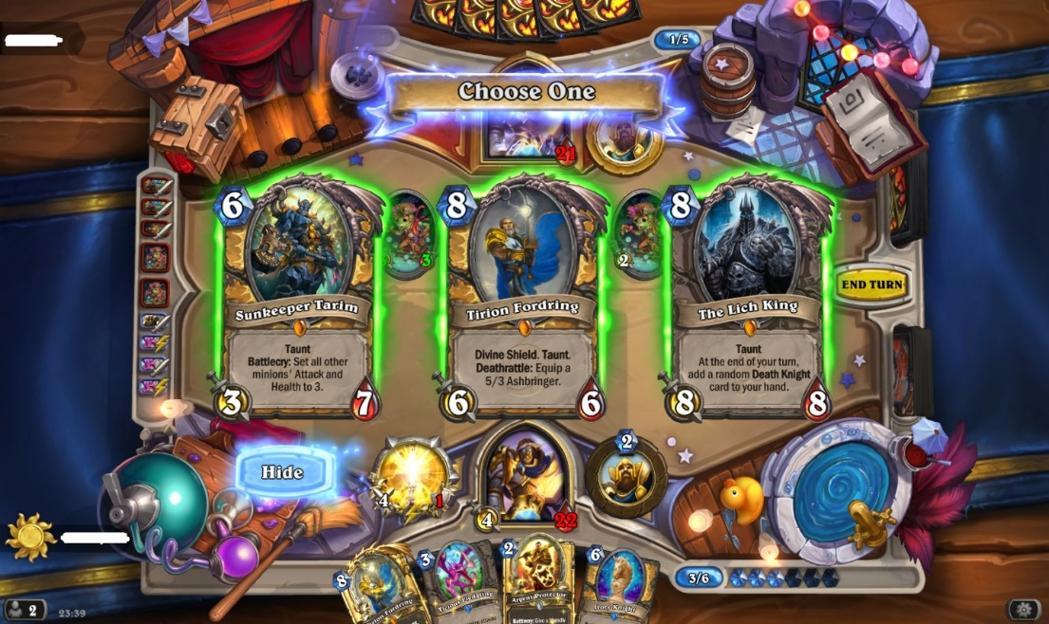
Task 1 – Where is the Information
Take a look at the following image, it is also in your worksheet.
Is it clear what every bit of information does?
What could you change to make it clearer?
Which of those points are clearer than the others?
Make a list of the points where information is being shown to the user.
Challenge D

Slide 9


Slide 10
Interactivity
An easy part to miss when developing a VG is the interactivity side.
Although elements such as camera and player movement are core interactive features, if they are the only true interactive elements, the game as a whole will be limited.
What does it mean if a media product is interactive?
The output of the product is directly affected by the user’s input.

Slide 11
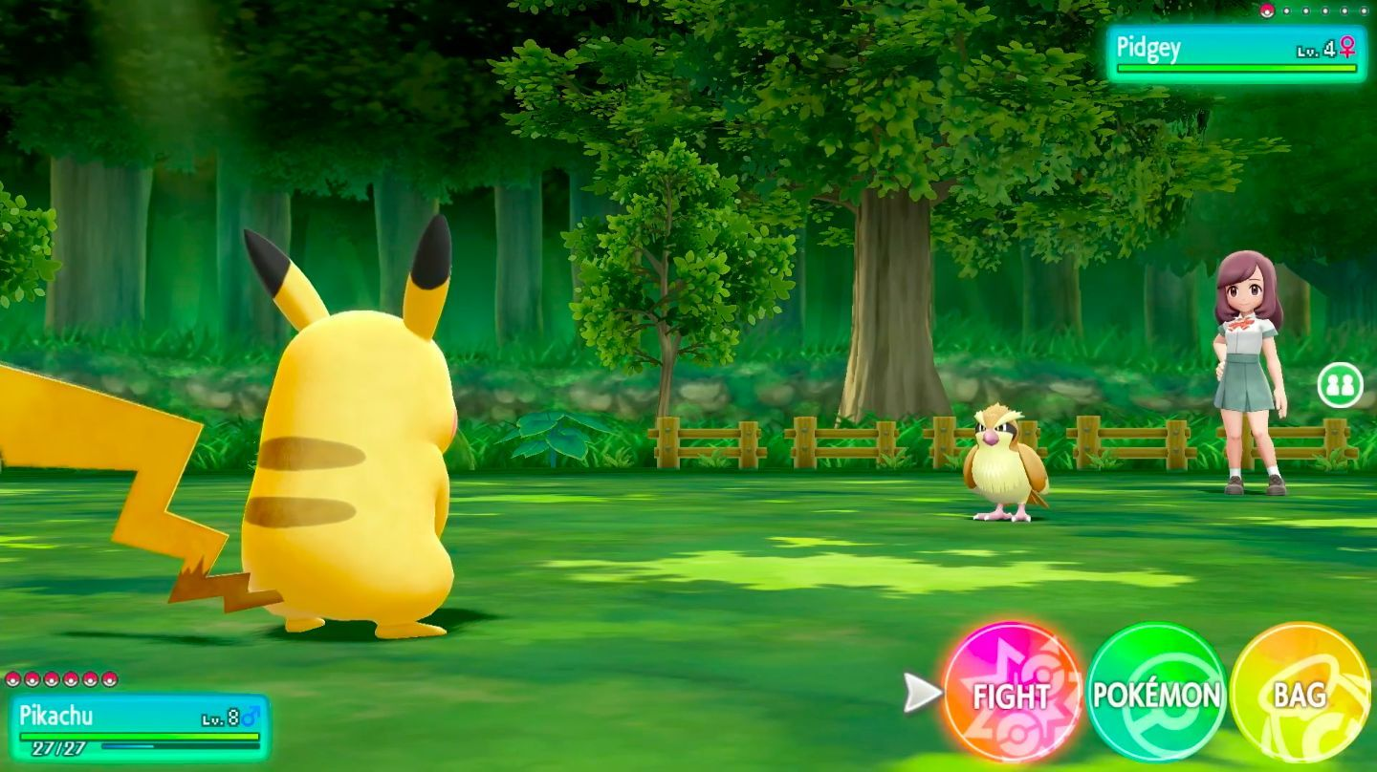
Interactivity – Example
Although this may appear as a simple battle scene within the game, there are a lot of elements with interactivity involved:
The player has moved in order to interact with the opponent.
The player has chosen a specific fighter to use.
The player will choose what option to use next.
There is a choice of attacks to use.
And several more.

Slide 12
Task 2 – State the Interactivity
Select a VG that you are familiar with, and as with the previous task, list how the product is actually interactive.
Explain the effects those 5+ features have on the product. Are they positive or negative?
What could you improve about the negative features?
Describe how 5+ of those features are interactive.
List the interactive features of the product. Include a screenshot with the task.
Note: You may find that some VGs are blocked, search the image before listing the features.
Challenge D

Slide 13
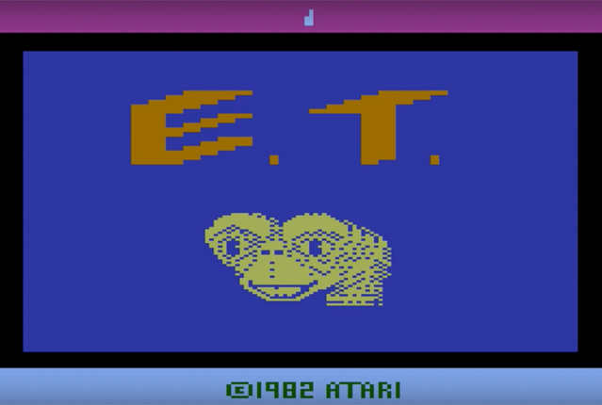
Interactivity and its Effects
Although some games are praised for their interactivity, such as Minecraft or Garry’s Mod due to the amount of flexibility within the game, there are examples where this isn’t the case.
E.T., released by ATARI in 1982, was acclaimed for it’s poor interactivity and lack of usability in general.

Slide 14
Plenary – Media and Interactivity
Select another VG that you are familiar with, different to the previous tasks.
List the interactive features of the VG.
Explain which of these show off the information well and which could do with improvements.
Take a screenshot of the game, highlight the points where information is being conveyed to the user.

